Slide 1

S O U T H L A K E H O M E E D U C A T O R S
Lesson 2
Programming Basics I: Sequences, Events & the Game Loop
Thursday, August 20, 2026

Slide 2


At a Glance
Lesson 2 objectives & materials
By the end of today, students will:
What We're Using Today
Explain sequences and why order matters
•
Demo laptop with all 8 engines verified
Explain events and give a game example
•
Scratch, for the live lecture demo
Describe the game loop concept
•
Engine-specific Student Handouts, one per student
Build a working Key Press Reactor - the start of the Semester 1 project
•
This lesson's Assets folder (placeholder sprite + sound - no download needed)
•
Your own Game Design Document, to start filling in during lab
IGDA framework tie-in: Programming - control structures and event-driven programming (introductory).
VIDEO GAME CREATION
Lesson 2
2

Slide 3

Today's Agenda
0:00 - 0:05
Welcome back, Lesson 1 recap, quick install spot-check
0:05 - 0:20
Sequences (live demo in Scratch)
0:20 - 0:35
Events (live demo in Scratch)
0:35 - 0:50
The Game Loop (concept + "under the hood" look)
0:50 - 1:00
Introduce lab exercise, hand out engine-specific handouts
LAB TIME
— Key Press Reactor —
1:00 - 1:50
Build the Key Press Reactor - the start of your Semester 1 project
1:50 - 2:00
Exit check: quick share-out
VIDEO GAME CREATION
Lesson 2
3

Slide 4

Welcome Back
Lesson 1 recap and a quick install spot-check before we dive in.
5 min
VIDEO GAME CREATION
Lesson 2
4

Slide 5

Welcome Back
5 min
Quick recap of Lesson 1:
Internet safety, what game development involves, and a tour of all 8 engines
Everyone chose (or shortlisted) an engine and started installing it
Today: our first real programming lesson - and the start of your Semester 1 project
If you didn't finish installing last week, that's okay - we've got a few minutes now, and Scratch and GDevelop work straight in a browser with zero install if you're in a pinch.
VIDEO GAME CREATION
Lesson 2
5

Slide 6

Sequences
The simplest idea in programming: instructions that happen one after another, in order.
15 min
VIDEO GAME CREATION
Lesson 2
6

Slide 7

Sequences
15 min
A sequence is a list of instructions that happen one after another, in order.
Think about your morning routine - wake up, get dressed, eat breakfast. If you get dressed before you wake up, that doesn't work. Order matters.
Live demo (Scratch):
move 10 steps → turn 15 degrees → say "Hello!"
Stacked blocks run top to bottom, one after another - every language we use this year (GDScript, C#, GML...) runs sequences like this at its core.
Discussion: what's something else in your daily life that has to happen in a specific order to work?
VIDEO GAME CREATION
Lesson 2
7

Slide 8

Events
Code that says "when this happens, do that" - the shift from running once to reacting.
15 min
VIDEO GAME CREATION
Lesson 2
8

Slide 9
Events
15 min
An event is code that waits, then reacts: "when this happens, do that."
Live demo (Scratch):
when [right arrow] key pressed → move 10 steps
Nothing happens until the key is pressed - and each press runs the whole sequence underneath it again.
Same idea, different names, across every engine:
Scratch
"when [key] pressed" hat block
What other events can you think of in games you've played?
Godot
signals, or checking Input inside _process()
Unity
Keyboard.current checks inside Update()
GameMaker
the Key Pressed / Key Down event
VIDEO GAME CREATION
Lesson 2
9

Slide 10
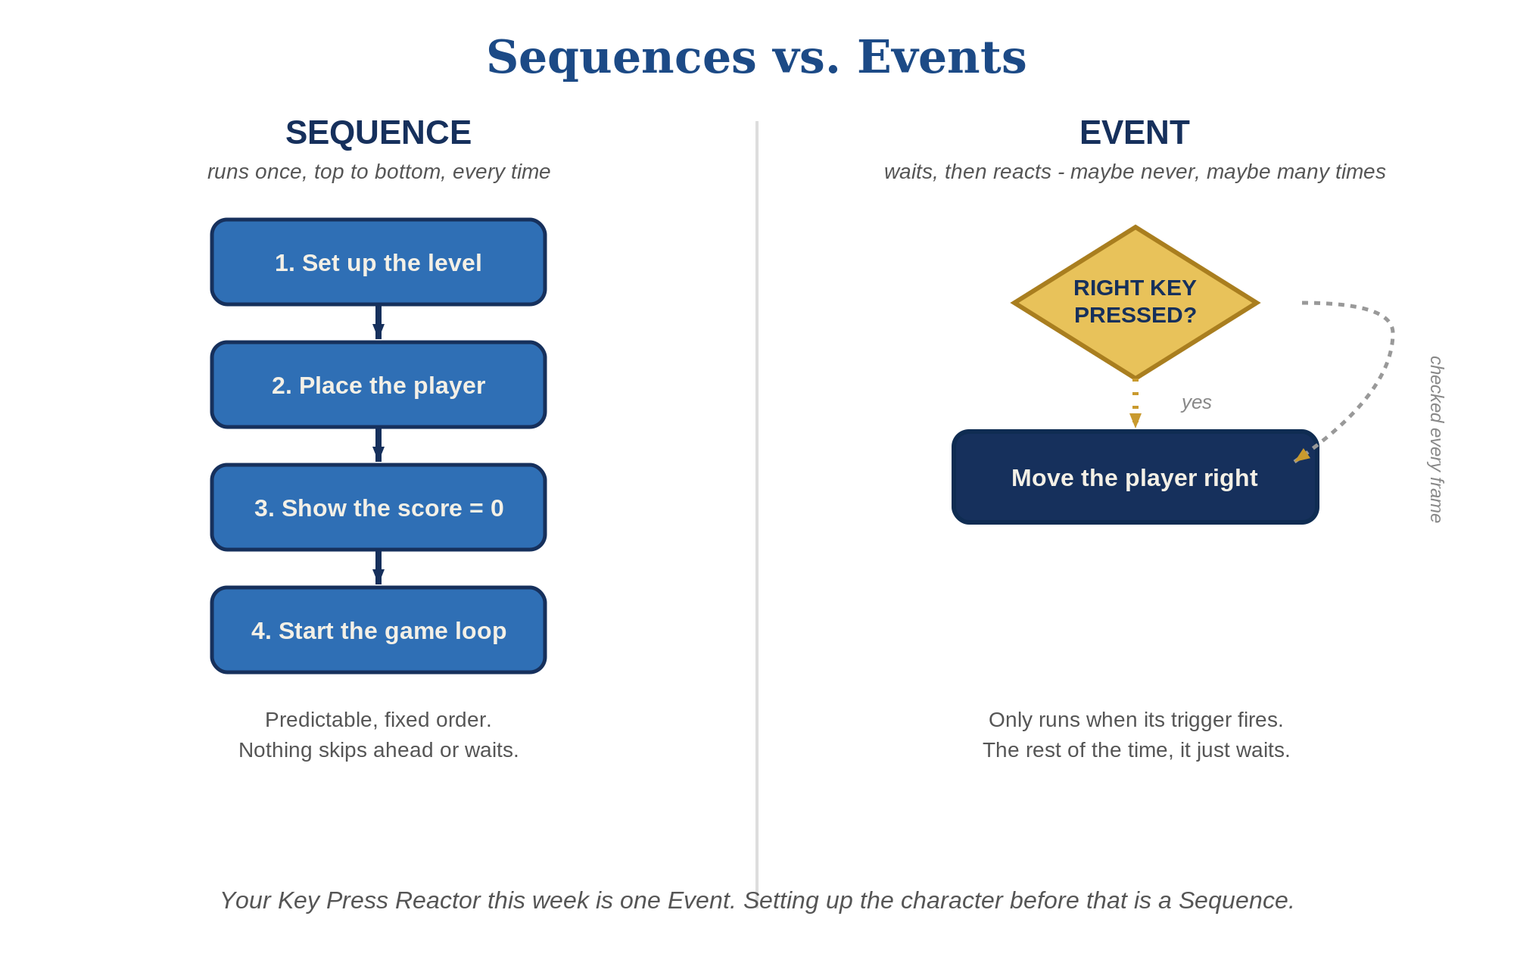
Sequences vs. Events - side by side
VIDEO GAME CREATION
Lesson 2
10

Slide 11

The Game Loop
How does a character keep moving smoothly while you hold a key? This is why.
15 min
VIDEO GAME CREATION
Lesson 2
11

Slide 12

The Game Loop
15 min
The engine isn't waiting for one event and stopping - it's constantly asking, ~30 to 60 times every second:
What's the current input?
What needs to move?
What needs to be redrawn?
That loop - check, update, draw, check, update, draw - happening dozens of times a second, is the game loop. You don't usually write it yourself; the engine runs it for you. Almost everything you build this year runs inside it.
Flip-book analogy: each page is slightly different, and flipping through them fast makes it look like smooth motion. Each "page" is one pass through the game loop.
VIDEO GAME CREATION
Lesson 2
12

Slide 13
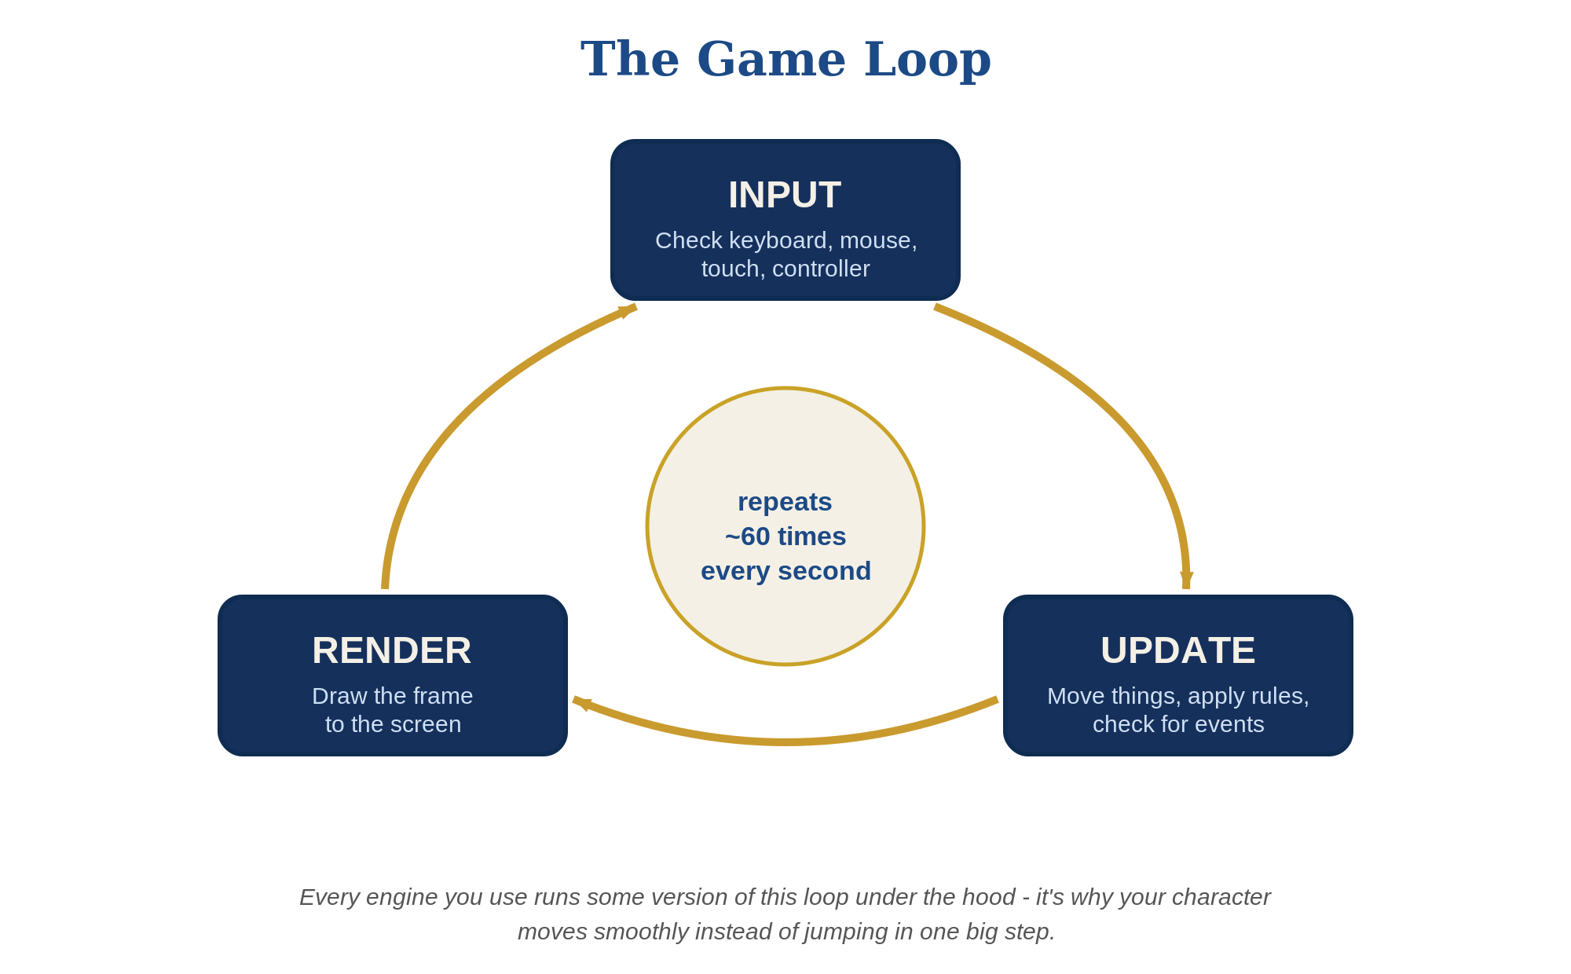
The Game Loop - Input, Update, Render
VIDEO GAME CREATION
Lesson 2
13

Slide 14


Bonus: Diagrams Programmers Use
BONUS
You just described the Game Loop in words. Professional game and software developers often draw it instead - using a couple of simple, standard diagram styles from UML (Unified Modeling Language).
Activity Diagram
State Diagram
Shows the order things happen in - like a flowchart. Next up: your Key Press Reactor as one.
Shows the different "modes" something can be in, and what switches it between them - like Idle vs. Moving.
We'll come back to a third kind - Class Diagrams - later in the year, once you're writing more object-oriented code.
VIDEO GAME CREATION
Lesson 2
14

Slide 15
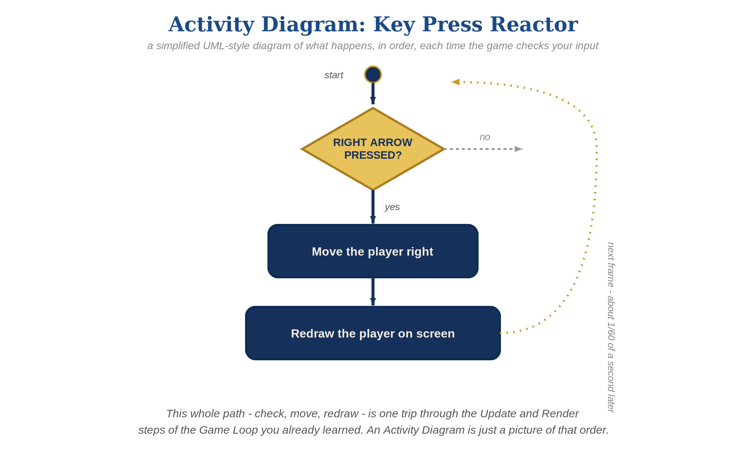
Activity Diagram - Key Press Reactor
BONUS
VIDEO GAME CREATION
Lesson 2
15

Slide 16
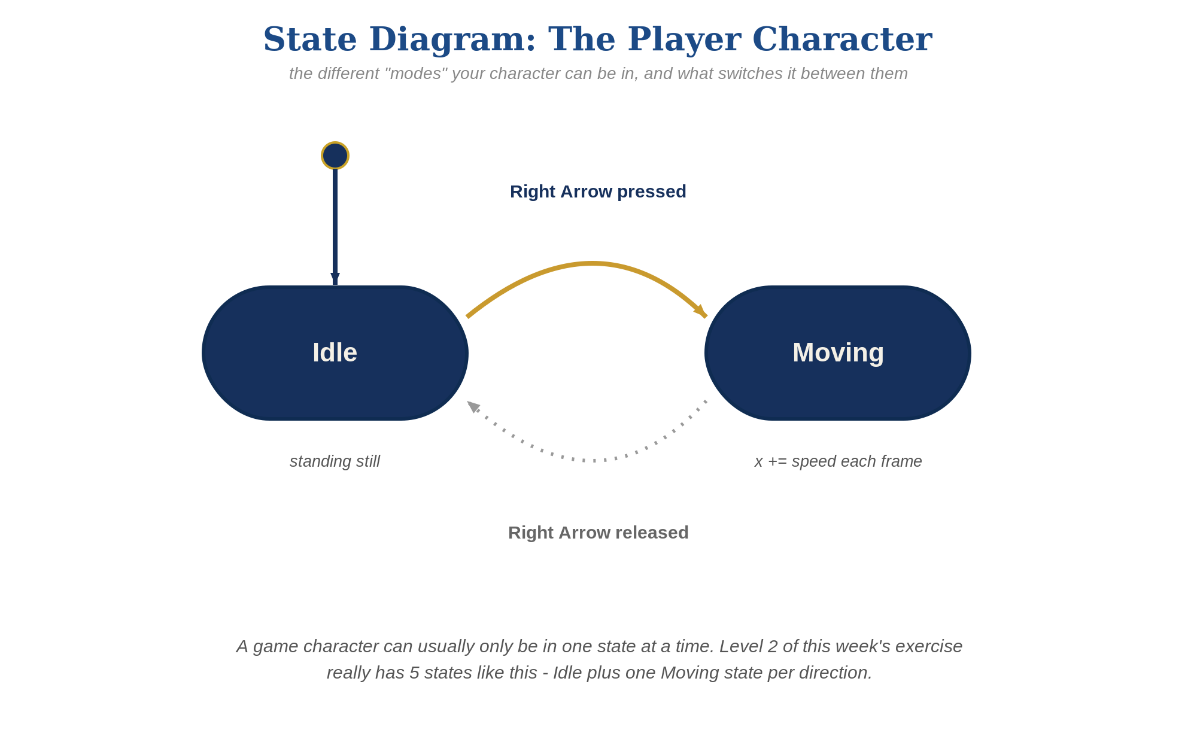
State Diagram - The Player Character
BONUS
VIDEO GAME CREATION
Lesson 2
16

Slide 17

Today's Exercise & Lab
The Key Press Reactor - and the very first piece of your Semester 1 project.
10 min
VIDEO GAME CREATION
Lesson 2
17

Slide 18
The Key Press Reactor
10 min
An object that responds when you press a key - and the very first piece of your Semester 1 project. Save it somewhere you'll remember, as [YourName]Game.
Level 1 - Minimal
Level 2 - Complete
Level 3 - Refined
One key does one thing.
All 4 arrow keys move your character.
Animation, sound, and/or polish - pick what interests you.
MVP - a complete finish for today.
Everything works end to end.
Ready to share.
New this lesson: 4 engines (GameMaker, Unity, Unreal, 001 Game Creator) get a second, alternate set of instructions on their handout - the other coding style (visual or scripted) for the exact same result. Try it if you're curious how the other side works.
VIDEO GAME CREATION
Lesson 2
18

Slide 19
Lab Time Notes
Circulate by engine cluster, starting with whichever engine has the most students this week.
Common early snag, every engine: an event block/node that isn't actually connected won't run. "Nothing happens" → check connections first.
Students who finish Level 2 early should be pointed at the Level 3 ideas on their handout - not given new unrelated work.
At 1:50, call time and do a 2-minute share-out: ask 2-3 students to show what they built, across different engines if possible.
VIDEO GAME CREATION
Lesson 2
19

Slide 20

Great Work Today!
Next week: more programming foundations - variables, loops, and conditionals.
Keep building on your Key Press Reactor at home if you'd like - and start jotting notes in your Game Design Document.
VIDEO GAME CREATION
Lesson 2
20

